Slide 1

WRAPPING UP
Carlos Leon
29 January 2014

Slide 2
TAKE HOME NOTES
1. LC-MS methodology, troubleshooting and method development: Lipid Analysis
2. Important considerations in long-term and large-scale studies, specially in terms of sample organization, treatment, analysis and data evaluation.
3. Tools and programs for processing of LC-MS data, both commercial Agilent softwares and other free available such as mzmine.
4. Strategies and tools for metabolomics data analysis, such as network mapping

Slide 3

1. LC-MS: Lipid method

Slide 4
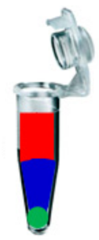
Method development: extraction
Isolation of a broad range of lipids
Preference of MTBE method over the Folch method; MTBE method easily completed (important in long-term metabolomics studies
Cholesteryl esters
Ceramides
Diacylglycerols
Free fatty acids
Lysophosphatidylcholines
Phosphatidic acid
Phosphatidylcholines
Phosphatidylethanolamines
Triacylglycerols
Sphingomyelins
Plasmenyl-phosphatidylethanolamines
Phosphatidylinositols
Plasmenyl-phosphatidylcholines
Phosphatidylglycerols
MTBE + MeOH
H₂O (+ MeOH)
Insoluble residue

Slide 5
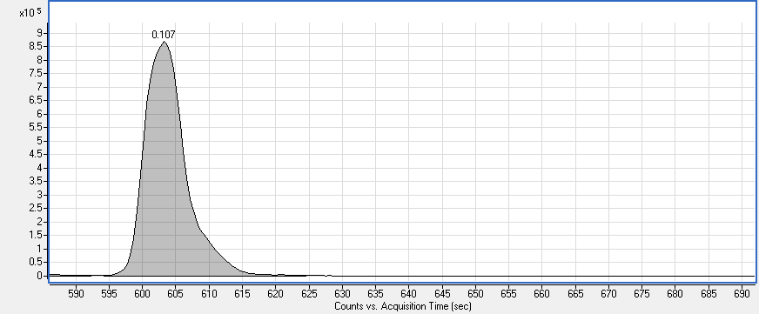
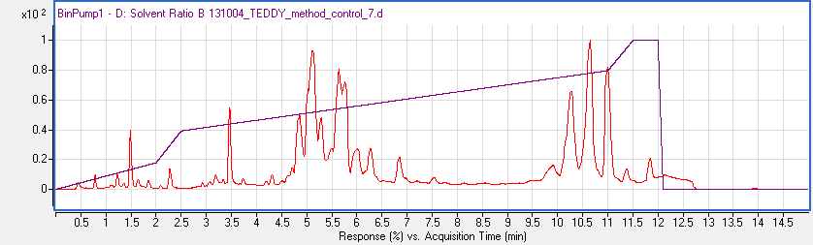
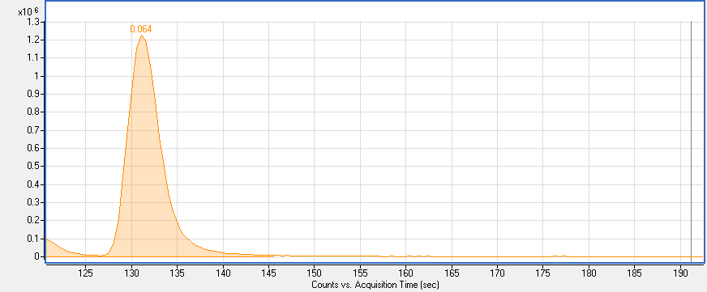
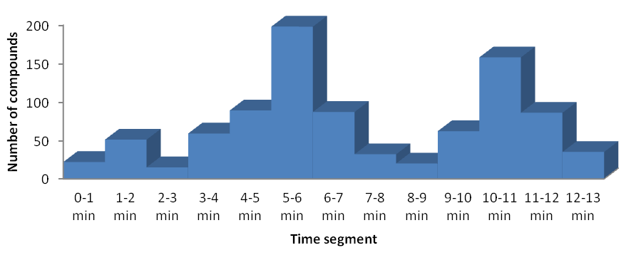
TG 50:3
FWHM 6.1 sec
Method Parameters
Temperature: 65ºC
Solvent A: 60:40 ACN:water + 10 mM Ammonium formiate + 0.1% HCOOH
Solvent B: 90:10 IPA:ACN +10 mM Ammonium formiate + 0.1% HCOOH
Flow rate: 0.6 ml/min
Injection volume: 1.7 μL
Acquity UPLC CSH C18 (100 × 2.1 mm; 1.7 µm)
ESI + mode
LPC 18:1
FWHM 3.6 sec
Acylcarnitines
LysoPC/LysoPE
DG/PC/PE/SM/Cer
TG/CE

Slide 6
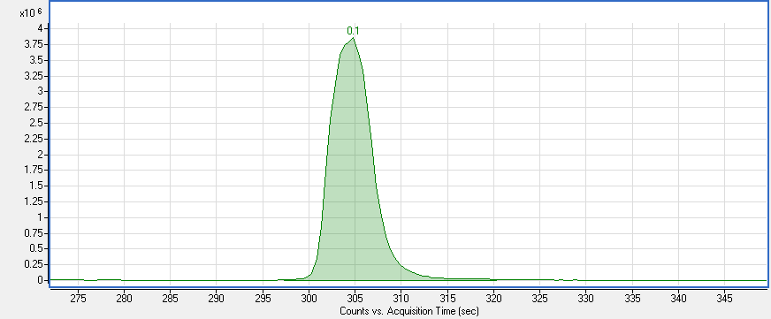
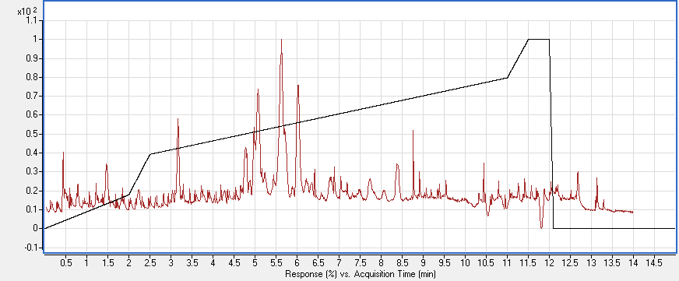
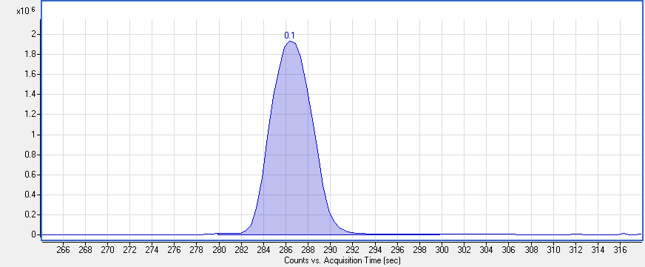
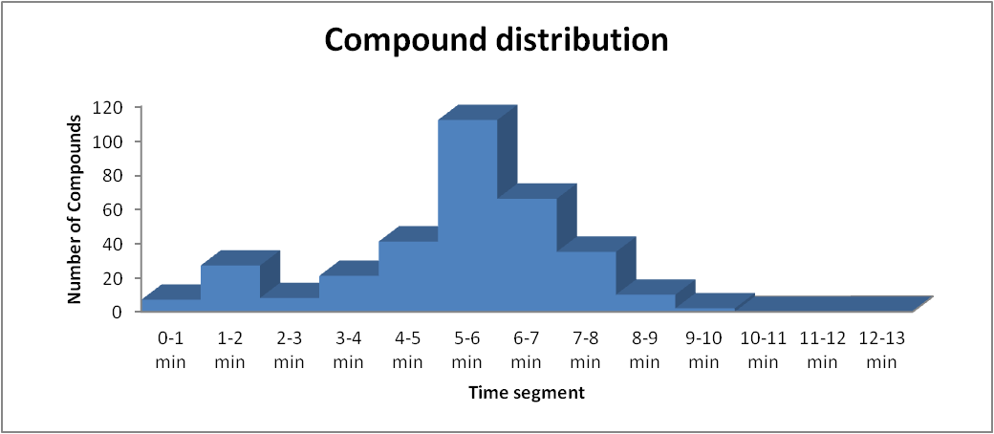
Method Parameters
Temperature: 65ºC
Solvent A: 60:40 ACN:water + 10 mM Ammonium formiate + 0.1% HCOOH
Solvent B: 90:10 IPA:ACN +10 mM Ammonium formiate + 0.1% HCOOH
Flow rate: 0.6 ml/min
Injection volume: 5 μL
Acquity UPLC CSH C18 (100 × 2.1 mm; 1.7 µm)
PC 34:2
FWHM 5.8 sec
ESI - mode
SM d34:1
FWHM 6 sec
LysoPC/LysoPE
FA
PI/PC/PE/SM/PG/PS
Cer

Slide 7
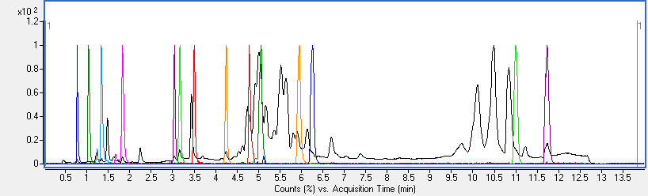
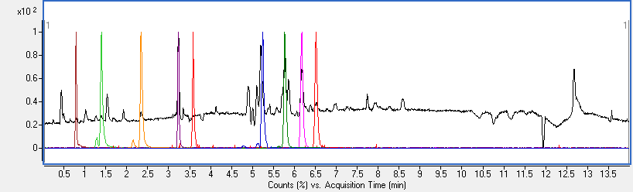
Positive mode
1
2
3
4
5
6
7
8
9
10
11
12
13
14
1
2
3
4
5
6
7
8
9
Negative mode
Positive mode
Negative mode
(1) CUDA
(2) Sphingosine (d17:1)
(3) LysoPE(17:1)
(4) LysoPC(17:0)
(5) MG(17:0/0:0/0:0)
(6) DG(18:1/2:0/0:0)
(7) PC(12:0/13:0)
(8) DG(12:0/12:0/0:0)
(9) d₇-Cholesterol
(10) SM(17:0)
(11) Cer (d18:1/17:0)
(12) PE(17:0/17:0)
(13) d₅-TG(17:0/17:1/17:0)
(14) CE(22:1)
(5) PC (12:0/13:0)
(6)SM(17:0)
(7) PG(17:0/17:0)
(8) Cer (d18:1/17:0)
(9) PE(17:0/17:0)
(1) CUDA
(2) LysoPE(17:1)
(3) LysoPC(17:0)
(4) d₃-Palmitic acid

Slide 8
Short term evaluation of the method
10 injections from the same vial/same extraction (technical replicates)
10 injections from different vials/10 extractions (analytical replicates)
Data was evaluated with Mass Hunter Quant
 | 10 Technical Replicates | 10 Analytical Replicates
FWHM (s) | 5.5 | 6.7
Height %RSD | 3.9 | 7.1
Concentration (ITSD corrected) %RSD | 2.6 | 6.8
RT Stdev (s) | 0.53 | 1.21
Peak Symmetry | 1.18 | 1.28
Mass Accuracy (ppm) | 3.53 | 4.03

Slide 9
Comparison of three LC/MS lipidomics methods
- 3 lipid analysis methods were compared
- 10 samples injected in each method
- Data evaluation was done using Mass Hunter Quant
Parameter | Method A TEDDY | Method B Waters¹ | Method C Oresic²
Run time (min) | 15 | 22 | 18
Retention Time RSD | 0.09% | 0.26% | 0.09%
Peak Height RSD | 3.90% | 5.20% | 8.20%
average FWHM (sec) | 5.52 | 7.5 | 4.32
Average Symmetry | 1.18 | 1.22 | 1.54
% RT usage | 76.67% | 73% | 42.78%
# ID'd compounds (non-overlapping) | 320 | n/a | 251
1- Lipid separation using UPLC with charged surface hybrid technology” Giorgis Isaac, Waters Corporation
2- Nygren et al, Chapter 15. T.O. Metz (ed.), Metabolic Profiling, Methods in Molecular Biology 708, 2011.

Slide 10
Lipid Annotations
ESI(+)
ESI(–)
Abr | Lipid class | n |  | Abr | Lipid class | n
Carn | Acylcarnitines | 6 |  | Cer | Ceramides | 14
CE | Cholesteryl Esters | 8 |  | FA | Fatty Acids | 7
Cer | Ceramides | 4 |  | GlcCer | Glucosylceramides | 6
Cho | Cholesterol | 1 |  | LPC | Lysophosphatidylcholines | 10
DG | Diacylglycerols | 5 |  | LPE | Lysophosphatidylethanolamines | 4
GlcCer | Glucosylceramides | 5 |  | PC | Phosphatidylcholines | 27
LPC | Lysophosphatidylcholines | 21 |  | p-PC | Plasmenyl-phosphatidylcholines | 16
PC | Phosphatidylcholines | 57 |  | PE | Phosphatidylethanolamines | 16
PE | Phosphatidylethanolamines | 4 |  | PI | Phosphatidylinositols | 13
p-PC | Plasmenyl-phosphatidylcholines | 27 |  | PG | Phosphatidylglycerols | 3
p-PE | Plasmenyl-phosphatidylethanolamines | 5 |  | p-PI | Plasmenyl-phosphatidylinositols | 2
SM | Sphingomyelins | 34 |  | p-PE | Plasmenyl-phosphatidylethanolamines | 15
TG | Triacylglycerols | 63 |  | PS | Phosphatidylserines | 7
U | Unknowns | 91 |  | SM | Sphingomyelins | 22
 |  |  |  | U | Unknowns | 96
Total |  | 331 |  | Total |  | 258
Overlapped between both methods
Ceramides | 4
GlcCer | 3
LPC | 10
PC | 25
p-PC | 11
PE | 4
p-PE | 4
SM | 21
Total annotated: 402 (240 positive mode 162 negative mode). 82 are overlapped in both modes

Slide 11

2. Evaluation of large scale and long term analysis

Slide 12
Method workflow
Pre-run injections
QC / NIST / blank
10 samples
QC / blank
10 samples
…
QC / blank
A batch is ≈ 300 samples
Randomization, block design
Blank and machine quality controls
Reference (QC) and reference standard sample (NIST blood)
Around 4000 TEDDY samples, 1200 P20 samples and much more other samples in other matrixes have been analyzed so far

Slide 13
Batch information
TEDDY samples have been analyzed in different batches along 11 months
- Each batch was run with a QC (citrate plasma) every 10 samples
Batch # | Batch old name | # samples/batch (excluding QCs) | Batch start date | Batch end date | # of QCs
1 | 1 | 300 | 2/14/2013 | 2/18/2013 | 34
2 | 2 | 300 | 3/22/2013 | 3/27/2013 | 31
3 | 3 | 300 | 3/29/2013 | 4/2/2013 | 32
4 | 2a | 332 | 6/12/2013 | 6/18/2013 | 34
5 | 2b | 318 | 9/17/2013 | 9/22/2013 | 36
6 | 2c | 370 | 9/23/2013 | 9/28/2013 | 40
7 | 3a | 338 | 10/22/2013 | 10/27/2013 | 35
8 | 3b | 311 | 10/28/2013 | 11/2/2013 | 32
9 | 3c | 342 | 11/4/2013 | 11/9/2013 | 39
10 | 4a | 302 | 12/9/2013 | 12/14/2013 | 31
11 | 4b | 340 | 12/16/2013 | 12/21/2013 | 35
12* | 4c | 326 | 1/7/2014 | 1/11/2014 | 34
Total |  | 3879 | 2/14/2013 | 1/11/2014 | 413
*Not processed yet

Slide 14
Chromatographic peak characteristics for all QC samples.
All parameters are calculated using the TEDDY data processing method (Mass Hunter Quant)
- Average of the QCs in all 11 processed batches
 | RT RSD (%) | RT STDEV (s) | FWHM (s) | Height RSD | Mass Accuracy | Symmetry | RT STDEV All (s)
Total (n=345) | 0.190 | 0.705 | 6.349 | 10.389 | 3.602 | 1.280 | 3.378
Acylcarnitines (n=6) | 0.474 | 0.366 | 3.963 | 16.673 | 3.379 | 1.434 | 1.335
LPCs (n=21) | 0.418 | 0.378 | 4.305 | 14.558 | 2.116 | 1.366 | 1.537
PCs (n=74) | 0.201 | 0.641 | 6.660 | 10.064 | 2.996 | 1.318 | 2.953
TGs (n=63) | 0.146 | 0.893 | 7.449 | 10.036 | 3.608 | 1.355 | 4.387
SM (n=34) | 0.148 | 0.524 | 6.150 | 14.679 | 4.152 | 1.283 | 3.047
Cer (n=9) | 0.150 | 0.658 | 5.663 | 14.664 | 5.860 | 1.080 | 3.456
PE (n=9) | 0.149 | 0.513 | 5.257 | 16.724 | 3.298 | 1.218 | 3.006
CE (n=8) | 0.108 | 0.670 | 5.735 | 8.142 | 2.749 | 1.099 | 3.681
DG (n=5) | 0.134 | 0.519 | 5.463 | 18.190 | 5.797 | 1.266 | 3.186
Unknowns (n=91) | 0.222 | 0.818 | 6.237 | 8.602 | 3.609 | 1.233 | 3.354
Total w/o unknowns (n=240) | 0.182 | 0.697 | 6.506 | 10.557 | 3.729 | 1.299 | 3.462

Slide 15
Raw Peak Height RSD (%)
 | Batch1 | Batch2 | Batch3 | Batch2a | Batch 2b | Batch2c | Batch3a | Batch3b | Batch 3c | Batch4a | Batch 4b | All
Total | 4.06 | 16.79 | 14.08 | 9.81 | 15.99 | 11.23 | 7.53 | 8.96 | 11.87 | 10.97 | 6.91 | 13.03
Acylcar | 7.56 | 28.30 | 21.96 | 17.79 | 20.43 | 16.85 | 15.07 | 13.74 | 14.60 | 19.22 | 12.46 | 28.54
LPCs | 6.64 | 22.89 | 19.02 | 14.80 | 20.38 | 15.58 | 10.15 | 12.53 | 15.48 | 16.46 | 8.34 | 20.09
PCs | 5.43 | 16.77 | 13.05 | 9.18 | 14.92 | 9.81 | 7.48 | 8.87 | 12.26 | 10.43 | 6.83 | 13.66
TGs | 3.63 | 15.74 | 14.04 | 8.61 | 16.38 | 12.22 | 6.83 | 8.86 | 11.24 | 10.29 | 6.96 | 11.93
SM | 6.54 | 22.14 | 18.41 | 15.91 | 21.16 | 15.53 | 10.76 | 12.49 | 16.14 | 16.14 | 9.22 | 23.50
Cer | 6.88 | 21.64 | 19.16 | 17.55 | 21.86 | 16.22 | 9.83 | 13.53 | 16.45 | 12.82 | 10.33 | 24.89
PE | 9.54 | 24.11 | 22.17 | 18.96 | 22.08 | 18.03 | 11.24 | 15.25 | 18.58 | 16.90 | 11.32 | 29.31
CE | 6.67 | 11.84 | 11.25 | 9.13 | 10.81 | 8.39 | 6.13 | 6.74 | 6.66 | 11.27 | 3.90 | 14.96
DAG | 7.44 | 20.81 | 20.09 | 19.36 | 29.11 | 24.03 | 11.50 | 18.78 | 19.01 | 20.40 | 11.85 | 43.03
Concentration RSD (%)
 | Batch1 | Batch2 | Batch3 | Batch2a | Batch 2b | Batch2c | Batch3a | Batch3b | Batch 3c | Batch4a | Batch 4b | All
Total | 4.21 | 3.75 | 4.45 | 3.59 | 6.87 | 5.14 | 3.06 | 5.61 | 3.84 | 4.56 | 3.07 | 10.86
Acylcar | 3.65 | 16.92 | 4.00 | 8.57 | 8.93 | 10.34 | 10.50 | 7.65 | 6.83 | 9.69 | 7.45 | 26.76
LPCs | 4.76 | 12.89 | 2.70 | 5.89 | 8.59 | 9.80 | 4.67 | 6.90 | 8.83 | 7.28 | 3.97 | 15.83
PCs | 7.23 | 7.79 | 8.63 | 11.30 | 9.86 | 8.35 | 5.44 | 26.63 | 7.84 | 11.89 | 4.30 | 19.25
TGs | 13.39 | 36.97 | 18.15 | 59.67 | 17.50 | 11.70 | 7.24 | 16.63 | 15.25 | 16.50 | 10.45 | 82.35
SM | 1.53 | 6.89 | 5.63 | 4.96 | 11.26 | 11.86 | 4.94 | 7.95 | 8.83 | 11.46 | 4.46 | 25.05
Cer | 3.47 | 6.59 | 3.52 | 5.27 | 8.51 | 8.16 | 5.44 | 8.04 | 9.39 | 9.31 | 5.79 | 14.85
PE | 8.51 | 24.01 | 3.76 | 17.77 | 12.93 | 12.33 | 4.35 | 8.71 | 10.21 | 9.56 | 6.53 | 20.67
CE | 7.21 | 6.08 | 9.23 | 5.83 | 7.26 | 5.80 | 5.06 | 7.74 | 4.68 | 5.58 | 4.53 | 11.68
DAG | 3.65 | 9.97 | 9.55 | 12.81 | 15.24 | 23.28 | 6.29 | 11.42 | 27.86 | 9.63 | 6.29 | 31.98

Slide 16
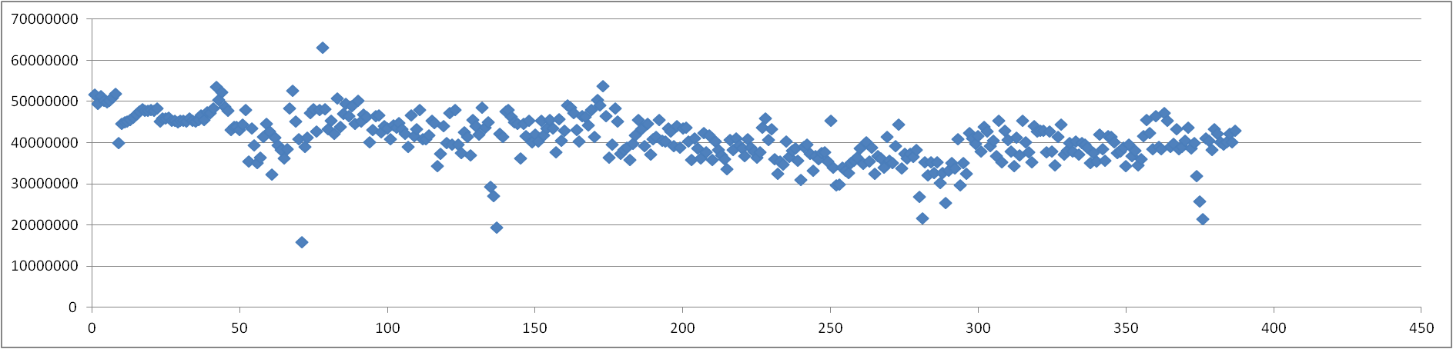
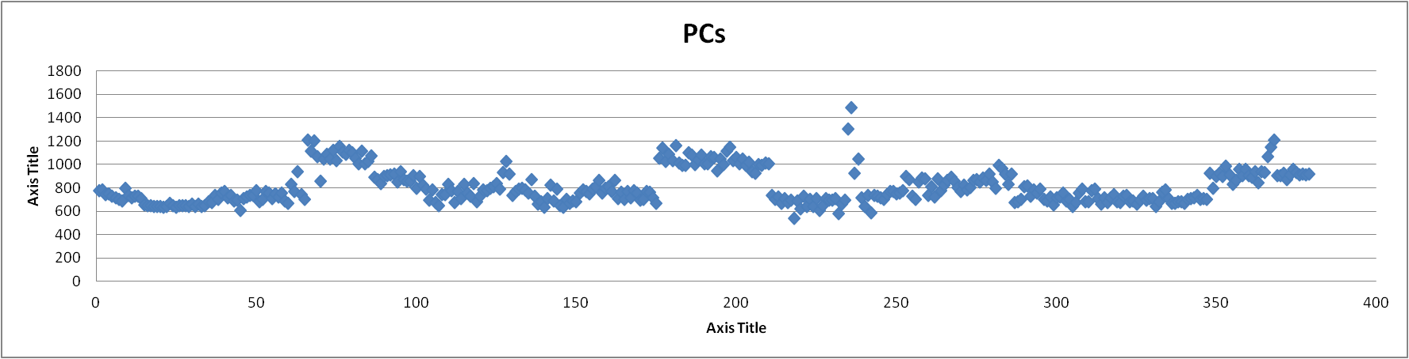
Raw peak height sum of all PCs
B1
B2
B2a
B2b
B2c
B3a
B3b
B3c
B4a
B4b
B3
Concentration sum of all PCs

Slide 17
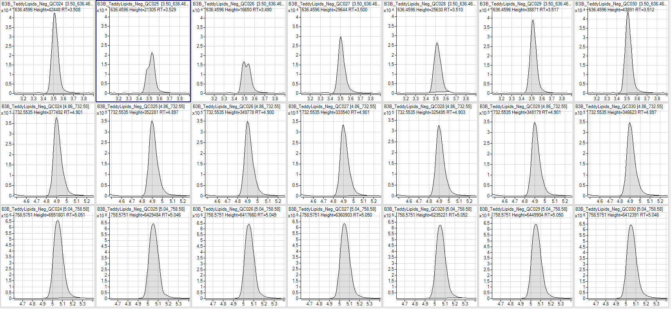
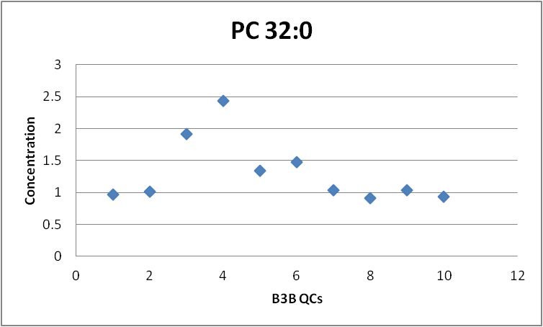
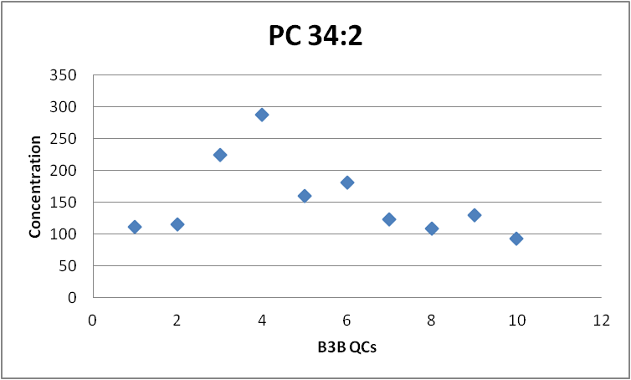
PC ISTD
PC 32:0
PC 34:2

Slide 18
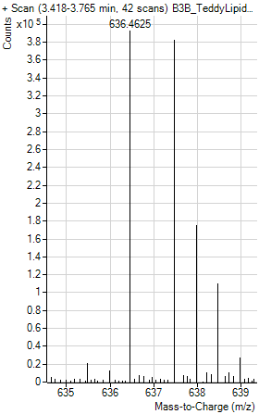
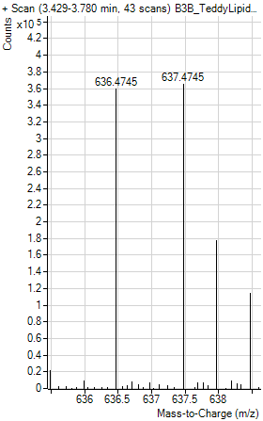
Coelution affected sensitivity and mass accuracy in those samples.
B3b ISTD PC QC25
B3b ISTD PC QC26
Mass error
2.6 mDa
4 ppm
Mass error
14.6 mDa
22.9 ppm

Slide 19
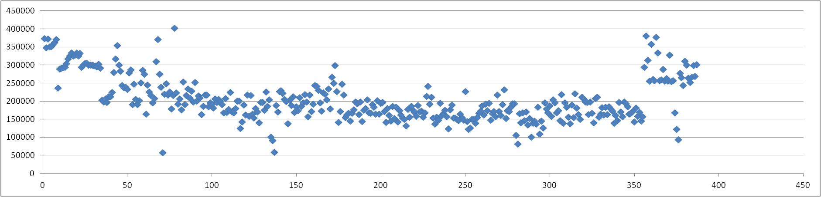
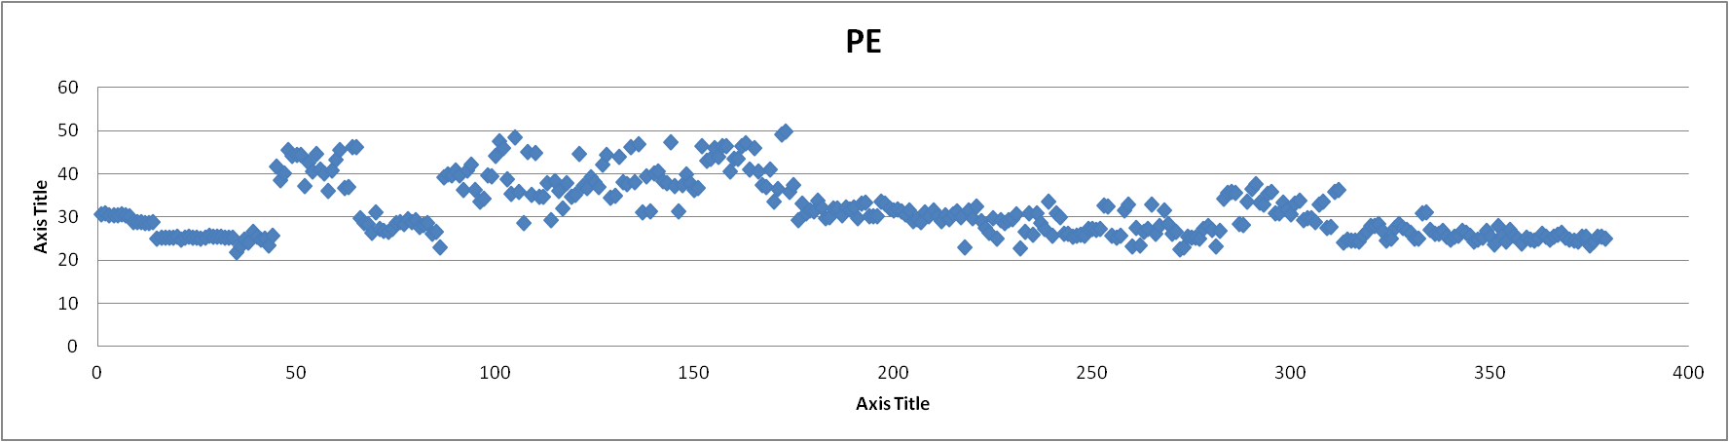
Raw peak height sum of all PEs
B1
B2
B2a
B2b
B2c
B3a
B3b
B3c
B4a
B4b
B3
Concentration sum of all PEs

Slide 20
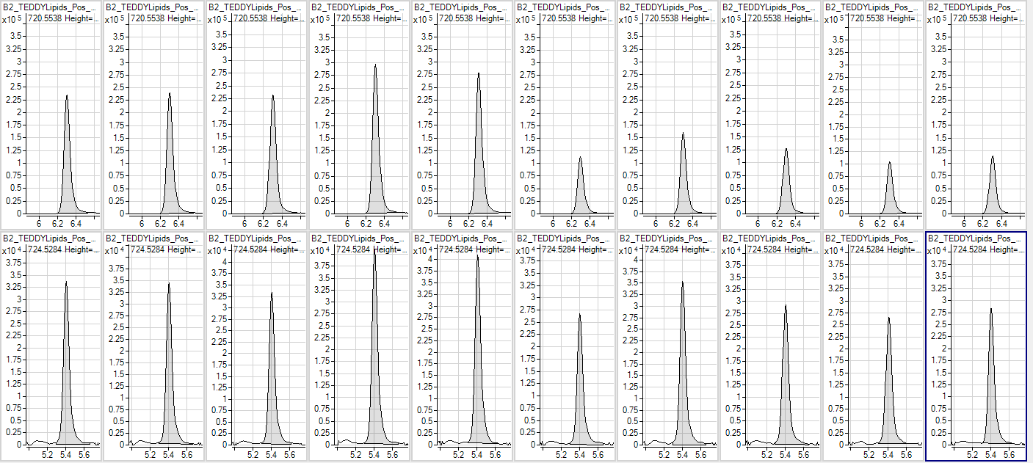
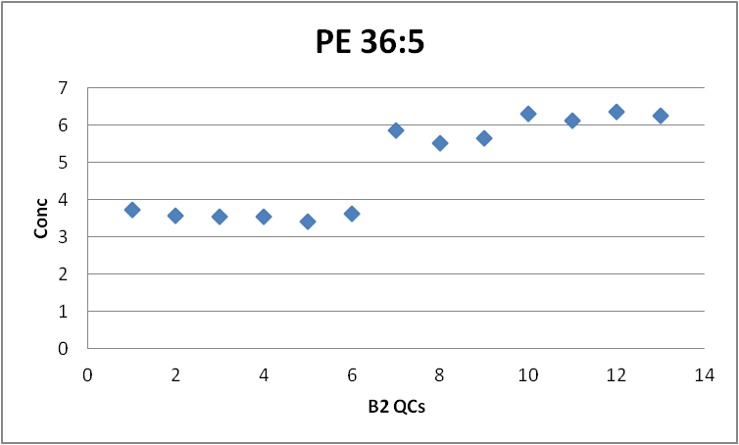
PE ISTD
PE 36:5
ISTD PE (PE 17:0/17:0) is suppressed in QC 10 to the end in this batch, so all the PEs at the end of the batch are overestimated compared to the ones at the beginning

Slide 21
Raw Peak Height RSD (%)
 | Batch1 | Batch2 | Batch3 | Batch2a | Batch 2b | Batch2c | Batch3a | Batch3b | Batch 3c | Batch4a | Batch 4b | All
Total | 4.06 | 16.79 | 14.08 | 9.81 | 15.99 | 11.23 | 7.53 | 8.96 | 11.87 | 10.97 | 6.91 | 13.03
Acylcar | 7.56 | 28.30 | 21.96 | 17.79 | 20.43 | 16.85 | 15.07 | 13.74 | 14.60 | 19.22 | 12.46 | 28.54
LPCs | 6.64 | 22.89 | 19.02 | 14.80 | 20.38 | 15.58 | 10.15 | 12.53 | 15.48 | 16.46 | 8.34 | 20.09
PCs | 5.43 | 16.77 | 13.05 | 9.18 | 14.92 | 9.81 | 7.48 | 8.87 | 12.26 | 10.43 | 6.83 | 13.66
TGs | 3.63 | 15.74 | 14.04 | 8.61 | 16.38 | 12.22 | 6.83 | 8.86 | 11.24 | 10.29 | 6.96 | 11.93
SM | 6.54 | 22.14 | 18.41 | 15.91 | 21.16 | 15.53 | 10.76 | 12.49 | 16.14 | 16.14 | 9.22 | 23.50
Cer | 6.88 | 21.64 | 19.16 | 17.55 | 21.86 | 16.22 | 9.83 | 13.53 | 16.45 | 12.82 | 10.33 | 24.89
PE | 9.54 | 24.11 | 22.17 | 18.96 | 22.08 | 18.03 | 11.24 | 15.25 | 18.58 | 16.90 | 11.32 | 29.31
CE | 6.67 | 11.84 | 11.25 | 9.13 | 10.81 | 8.39 | 6.13 | 6.74 | 6.66 | 11.27 | 3.90 | 14.96
DAG | 7.44 | 20.81 | 20.09 | 19.36 | 29.11 | 24.03 | 11.50 | 18.78 | 19.01 | 20.40 | 11.85 | 43.03
Batch normalization is done dividing each variable by the batch average and multiplying by the total average
Concentration RSD (%)
 | Batch1 | Batch2 | Batch3 | Batch2a | Batch 2b | Batch2c | Batch3a | Batch3b | Batch 3c | Batch4a | Batch 4b | All
Total | 4.21 | 3.75 | 4.45 | 3.59 | 6.87 | 5.14 | 3.06 | 5.61 | 3.84 | 4.56 | 3.07 | 10.86
Acylcar | 3.65 | 16.92 | 4.00 | 8.57 | 8.93 | 10.34 | 10.50 | 7.65 | 6.83 | 9.69 | 7.45 | 26.76
LPCs | 4.76 | 12.89 | 2.70 | 5.89 | 8.59 | 9.80 | 4.67 | 6.90 | 8.83 | 7.28 | 3.97 | 15.83
PCs | 7.23 | 7.79 | 8.63 | 11.30 | 9.86 | 8.35 | 5.44 | 26.63 | 7.84 | 11.89 | 4.30 | 19.25
TGs | 13.39 | 36.97 | 18.15 | 59.67 | 17.50 | 11.70 | 7.24 | 16.63 | 15.25 | 16.50 | 10.45 | 82.35
SM | 1.53 | 6.89 | 5.63 | 4.96 | 11.26 | 11.86 | 4.94 | 7.95 | 8.83 | 11.46 | 4.46 | 25.05
Cer | 3.47 | 6.59 | 3.52 | 5.27 | 8.51 | 8.16 | 5.44 | 8.04 | 9.39 | 9.31 | 5.79 | 14.85
PE | 8.51 | 24.01 | 3.76 | 17.77 | 12.93 | 12.33 | 4.35 | 8.71 | 10.21 | 9.56 | 6.53 | 20.67
CE | 7.21 | 6.08 | 9.23 | 5.83 | 7.26 | 5.80 | 5.06 | 7.74 | 4.68 | 5.58 | 4.53 | 11.68
DAG | 3.65 | 9.97 | 9.55 | 12.81 | 15.24 | 23.28 | 6.29 | 11.42 | 27.86 | 9.63 | 6.29 | 31.98

Slide 22
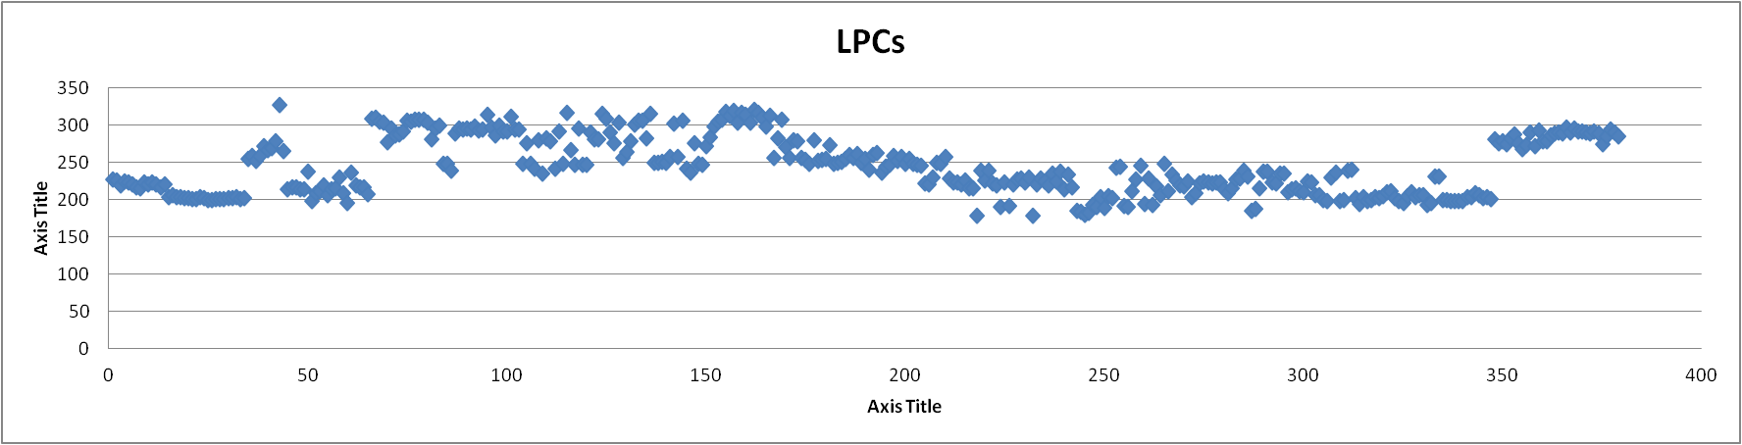
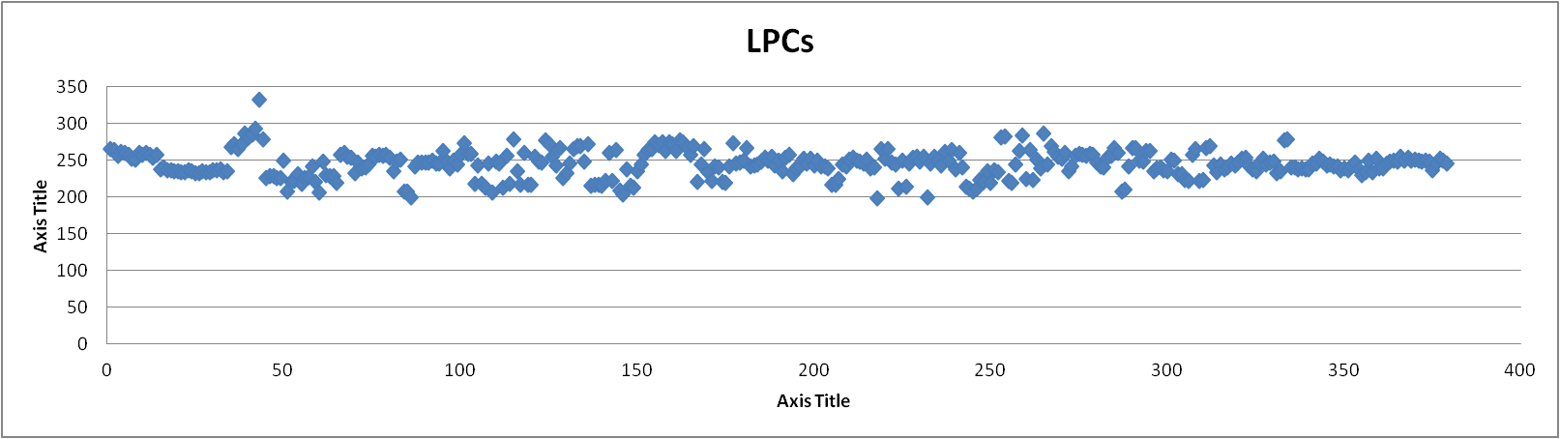
before Batch normalization
B1
B2
B2a
B2b
B2c
B3a
B3b
B3c
B4a
B4b
B3
after Batch normalization

Slide 23
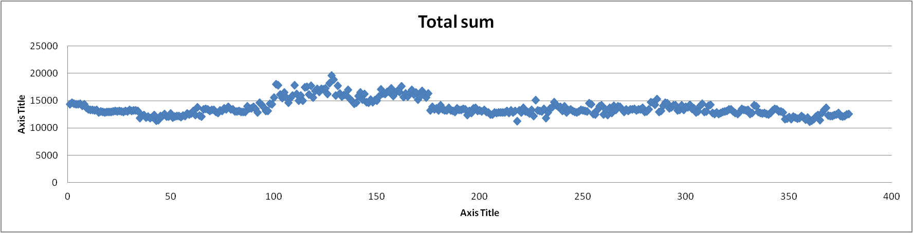
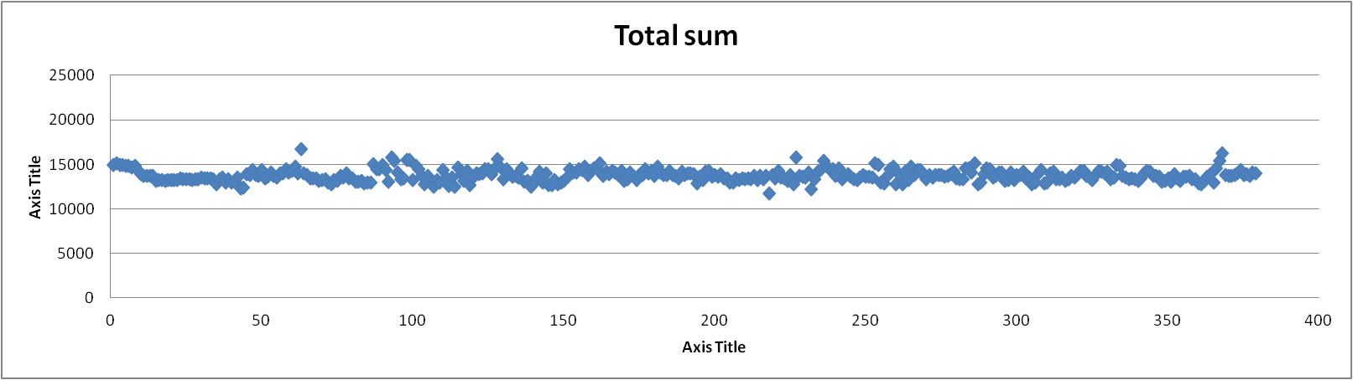
before Batch normalization
B1
B2
B2a
B2b
B2c
B3a
B3b
B3c
B4a
B4b
B3
after Batch normalization

Slide 24
Concentration RSD before Batch normalization
 | Batch1 | Batch2 | Batch3 | Batch2a | Batch 2b | Batch2c | Batch3a | Batch3b | Batch 3c | Batch4a | Batch 4b | All
Total | 4.21 | 3.75 | 4.45 | 3.59 | 6.87 | 5.14 | 3.06 | 5.61 | 3.84 | 4.56 | 3.07 | 10.95
Acylcarn | 3.65 | 16.92 | 4.00 | 8.57 | 8.93 | 10.34 | 10.50 | 7.65 | 6.83 | 9.69 | 7.45 | 25.64
LPCs | 4.76 | 12.89 | 2.70 | 5.89 | 8.59 | 9.80 | 4.67 | 6.90 | 8.83 | 7.28 | 3.97 | 15.54
PCs | 7.23 | 7.79 | 8.63 | 11.30 | 9.86 | 8.35 | 5.44 | 26.63 | 7.84 | 11.89 | 4.30 | 18.04
TGs | 13.39 | 36.97 | 18.15 | 59.67 | 17.50 | 11.70 | 7.24 | 16.63 | 15.25 | 16.50 | 10.45 | 81.67
SM | 1.53 | 6.89 | 5.63 | 4.96 | 11.26 | 11.86 | 4.94 | 7.95 | 8.83 | 11.46 | 4.46 | 24.82
Cer | 3.47 | 6.59 | 3.52 | 5.27 | 8.51 | 8.16 | 5.44 | 8.04 | 9.39 | 9.31 | 5.79 | 14.98
PE | 8.51 | 24.01 | 3.76 | 17.77 | 12.93 | 12.33 | 4.35 | 8.71 | 10.21 | 9.56 | 6.53 | 20.81
CE | 7.21 | 6.08 | 9.23 | 5.83 | 7.26 | 5.80 | 5.06 | 7.74 | 4.68 | 5.58 | 4.53 | 11.79
DAG | 3.65 | 9.97 | 9.55 | 12.81 | 15.24 | 23.28 | 6.29 | 11.42 | 27.86 | 9.63 | 6.29 | 31.61
 | Batch1 | Batch2 | Batch3 | Batch2a | Batch 2b | Batch2c | Batch3a | Batch3b | Batch 3c | Batch4a | Batch 4b | All
Total | 4.85 | 5.75 | 5.12 | 6.31 | 5.38 | 4.81 | 3.14 | 5.78 | 4.02 | 4.53 | 3.24 | 4.82
Acylcarn | 3.56 | 16.88 | 4.02 | 8.56 | 8.95 | 10.34 | 10.51 | 7.66 | 6.68 | 9.71 | 7.46 | 9.03
LPCs | 4.82 | 12.39 | 2.72 | 5.88 | 8.64 | 9.84 | 4.64 | 6.90 | 8.81 | 7.28 | 3.98 | 7.35
PCs | 7.30 | 8.35 | 8.93 | 11.16 | 9.83 | 10.43 | 5.41 | 26.36 | 7.85 | 12.17 | 4.28 | 11.34
TGs | 13.69 | 37.66 | 17.27 | 60.13 | 16.34 | 11.73 | 7.23 | 16.48 | 15.32 | 16.37 | 10.44 | 24.28
SM | 1.64 | 6.77 | 5.77 | 5.02 | 11.17 | 11.93 | 4.96 | 7.88 | 9.08 | 11.50 | 4.46 | 8.04
Cer | 4.25 | 6.96 | 3.43 | 6.06 | 8.56 | 8.39 | 5.37 | 8.14 | 9.42 | 8.60 | 5.88 | 7.04
PE | 8.52 | 24.00 | 3.73 | 17.80 | 12.92 | 12.36 | 4.35 | 8.71 | 10.21 | 9.56 | 6.54 | 11.90
CE | 7.23 | 6.10 | 9.34 | 5.90 | 7.18 | 5.87 | 4.98 | 7.79 | 4.66 | 5.51 | 4.52 | 6.30
DAG | 2.96 | 9.01 | 8.34 | 12.93 | 16.41 | 22.43 | 6.86 | 11.53 | 24.52 | 9.92 | 6.49 | 13.84
Concentration RSD after Batch normalization
Batch normalization is done dividing each variable by the batch average and multiplying by the total average

Slide 25
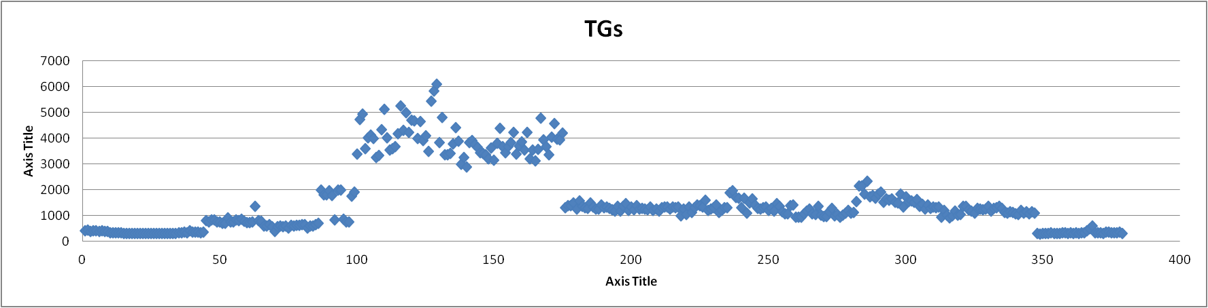
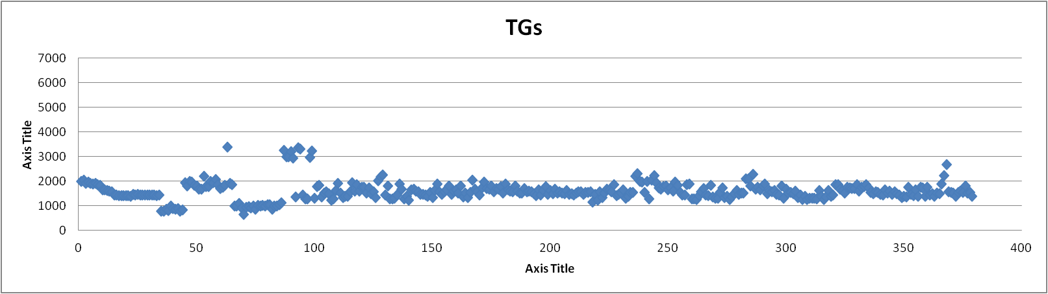
before Batch normalization
B1
B2
B2a
B2b
B2c
B3a
B3b
B3c
B4a
B4b
B3
after Batch normalization

Slide 26
RSD of the sum of all TGs using different normalization approaches
 | Batch1 | Batch2 | Batch2a | Batch 2b | Batch2c | Batch3a | Batch3b | Batch 3c | Batch4a | Batch 4b | Batch3 | All batches
Raw height | 3.63 | 15.74 | 8.61 | 16.38 | 12.22 | 6.83 | 8.86 | 11.24 | 10.29 | 6.96 | 14.04 | 11.93
Normalized by total sum | 3.95 | 3.37 | 1.97 | 2.19 | 2.43 | 1.18 | 2.44 | 1.49 | 1.26 | 1.30 | 2.07 | 7.09
Normalized with TG ISTD | 13.39 | 36.97 | 59.67 | 17.5 | 11.7 | 7.24 | 16.63 | 15.25 | 16.5 | 10.45 | 18.15 | 81.67
Normalized with TG-BN | 13.69 | 37.66 | 60.13 | 16.34 | 11.73 | 7.23 | 16.48 | 15.32 | 16.37 | 10.44 | 17.27 | 24.28
Normalized with DG | 7.29 | 13.30 | 9.50 | 14.93 | 15.83 | 16.05 | 9.71 | 28.49 | 18.78 | 10.22 | 24.54 | 28.87
Normalized with DG-BN | 7.24 | 13.42 | 10.72 | 15.00 | 15.81 | 16.03 | 9.78 | 28.46 | 18.58 | 10.10 | 24.12 | 17.58
Normalized with CE | 14.01 | 13.74 | 11.34 | 9.90 | 9.52 | 5.78 | 14.05 | 9.07 | 11.40 | 7.82 | 10.99 | 35.25
Normalized with CE -BN | 14.15 | 13.50 | 11.33 | 10.00 | 9.53 | 5.80 | 14.07 | 9.22 | 11.31 | 7.87 | 10.93 | 10.73
BN-Batch Normalized

Slide 27
Conclusions
1. A fast LC/MS and robust method for untargeted lipidomics with a throughput of 15 minutes per sample.
2. Over 4000 thousand samples have been analyzed and used for the evaluation of long term large scale studies
3. Data processing is the most challenging step, from data pre-processing (normalization) to intra-batch variability. Every step needs to be carefully revised and the causes (raw data) of the variation checked.
Paper: A Robust and Validated High Throughput Method for Long Term and Large Scale (LOTLAS) Lipidomics

Slide 28

3. Tools for LC-MS Data Processing

Slide 29


Data processing: MH Quant, mzmine…
MZMINE 2.10
MH QUANT 6.00
Untargeted approach
Targeted approach
Mzmine is less time consuming in data processing time and easier to apply.
The output of mzmine is peak height and area, while Quant’s output is much broader (concentrations , height, area, FWHM, symmetry…).
Quant does a better job in peak picking and has less missing values (and can manually integrate).
- The use of ISTDs for RT correction in different batches can only be achieved with Quant

Slide 30
Mzmine workflow
MZMINE 2.10
Untargeted approach
Raw data import (mzdata files)
Mass detection (noise threshold 2E03 counts)
Chromatogram builder
Chromatogram deconvolution
Isotopic peaks grouper
Alignment
Filtering (row and duplicate filters)
Gap-filling
Custom database search
Export

Slide 31
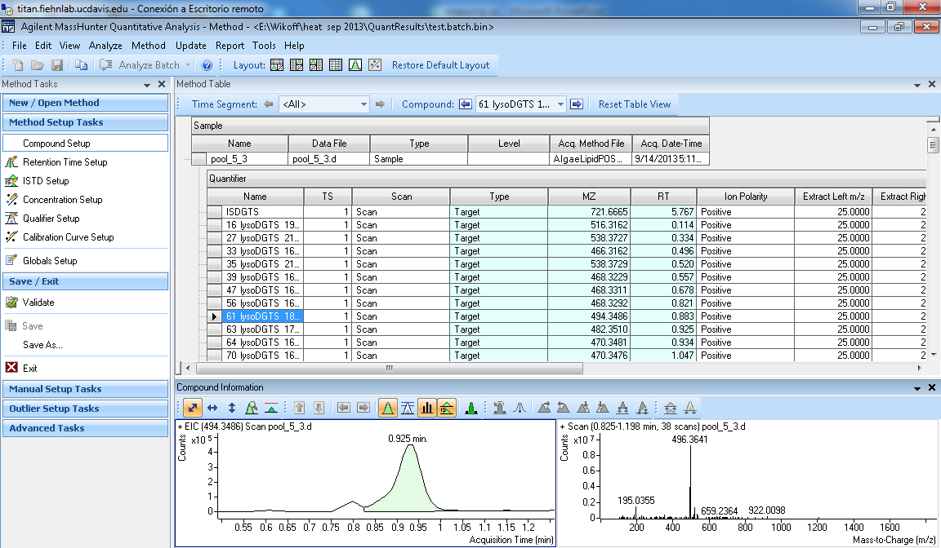
Quant workflow
MH QUANT 6.00

Slide 32
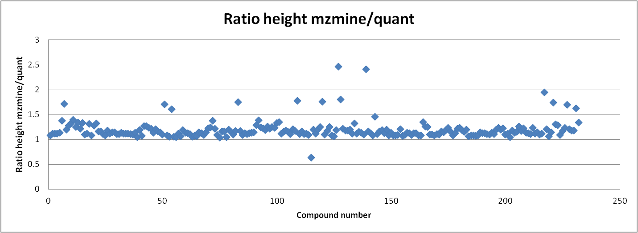
Data processing: MH Quant, mzmine…
558 compounds found in mzmine
442 compounds are annotated in MH Quant
232 were coincident between both methods (RT and mz matching)
Some differences are observed in terms of peak height (average of 87% of the intensity reported by Quant related to the one reported in mzmine) (smoothing)

Slide 33
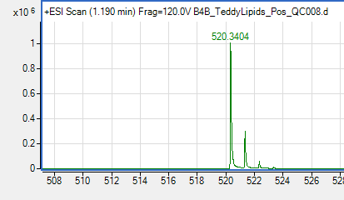
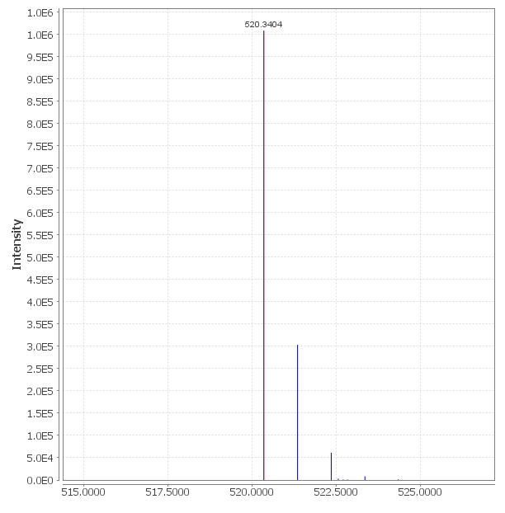
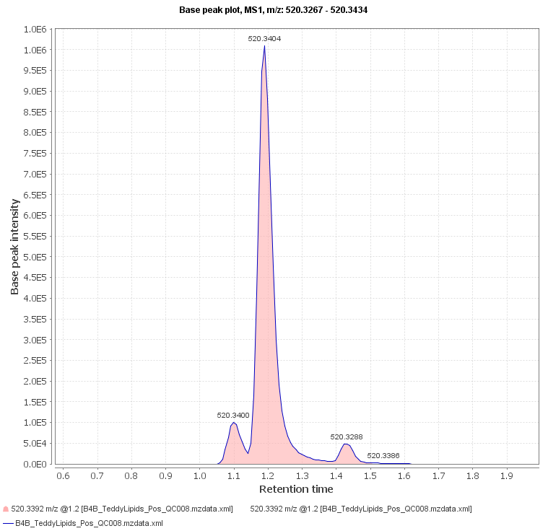
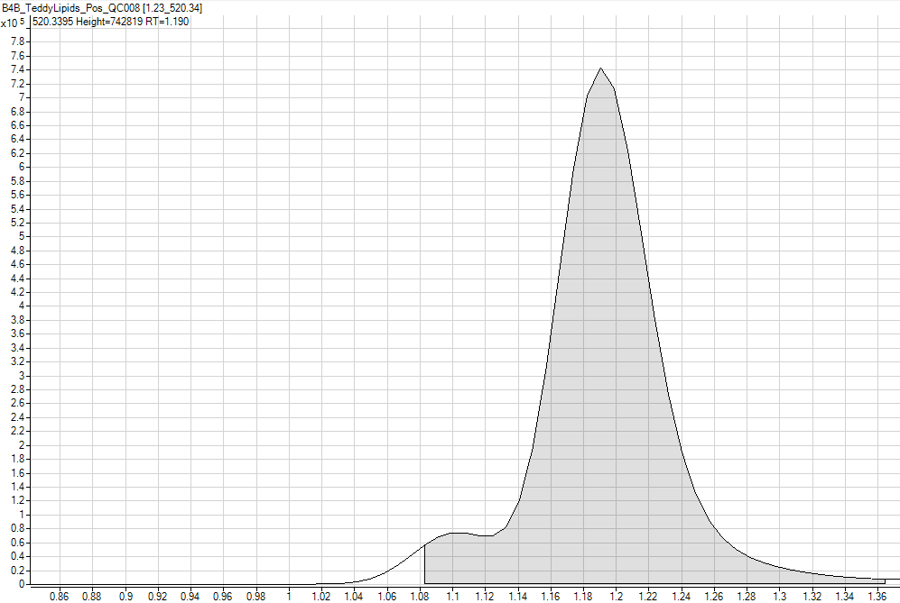
Differences in peak height in mzmine and quant
Smoothing is responsible for differences in peak height
PH:1008497
PH:742819
LPC 18:2
[M+H]⁺
m/z: 520.3395
LPC 18:2
[M+H]⁺
m/z: 520.3395

Slide 34
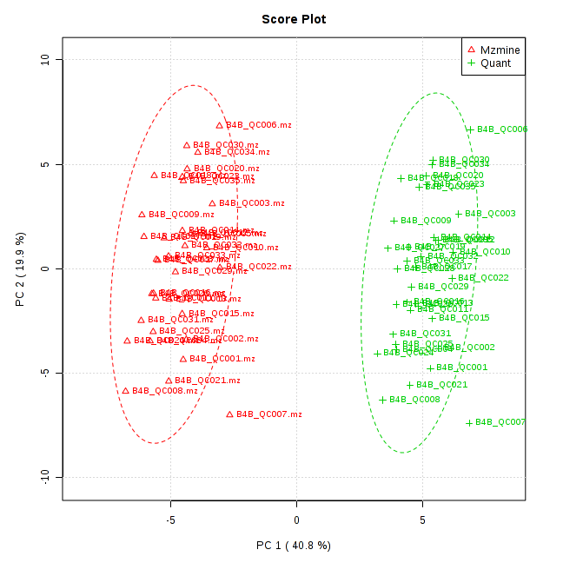
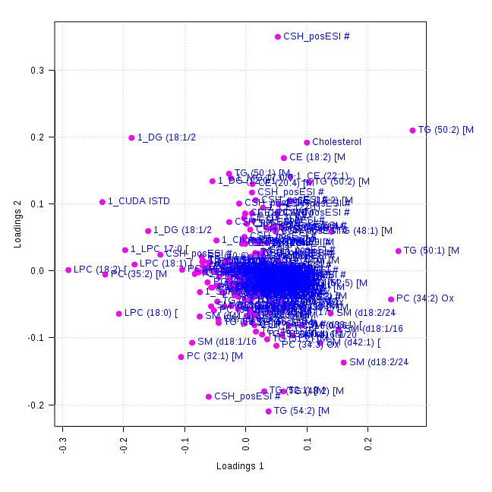
PCA done in these 233 compounds (peak height)
The PCA accounts for the peak height differences, but the sample variance is the same using mzmine and quant

Slide 35

4. Tools for Data Analysis: Network mapping

Slide 36
Chronic heart failure study design
Surgery
Shenfu decoction treatment
M, My1, J, Jy1, K, Ky1 (n=8)
M, J, K
Weeks
1
2
3
4
5
6
7
8
9
10
11
Urine samples
Hemodynamic experiments
Hemodynamic experiments
Hemodynamic experiments
Surgery group, (M); S-treated (My1); S-non-treated (M)
Sham-Surgery group (J); SS-treated (Jy1); SS-non-treated (J)
Control group (K); C-treated (Ky1);C-non-treated (K)
Notes:
Pharmacological effects.
Thanks prof.yan and dr wangmei and prof xu give me this chance, It is my pleasure to present my study design.
The aim of
In this study, the heart failure of rats will be performed by ligation by ligating the left ventricular coronary artery.
Before the surgery, we collect urine and blood sample. And take small animal B untrasond exprements (aim?)before the collecting samples, rats will be fasted about 12hours and free water.latitudinal longitudinal
After the surgery, we collect unrine samples once a week, and in the fourth week, we select 8 rats from each group (you kown model, sham and control) to take hemodymamic experi and small animal b ultrasound and then we collect blood sam at last the rats would be die.
The same procesure in the fith to eighth week.in the eighth week, hemodynamic findings and some results from small animal b ultrasoun tell us the rats have developed heart failure, so we give the decoction to rats. We are going to give decotion for two weeks. 0.5 gram of crude herbs pr milliter of test solution.accoding to clinical usage.hemodynamic and some results can give us pharmacological effects.we hope our results of metabolomics study consist with pharmacological results.
We test blank sam unrine 48 and 48 each from the first week tenth week and
The total about more than 500
Blood 24 blank samples and 24 in the fourth and the eighth 48 sampls in tenth.about more than 100.

Slide 37
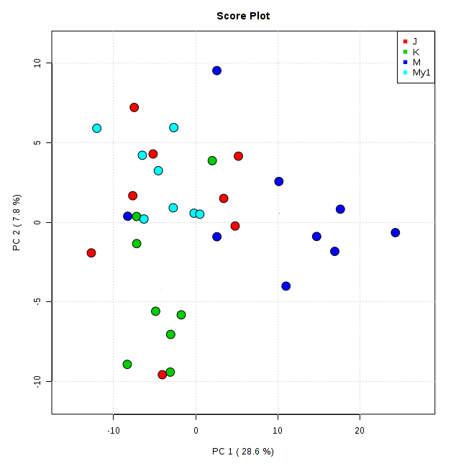
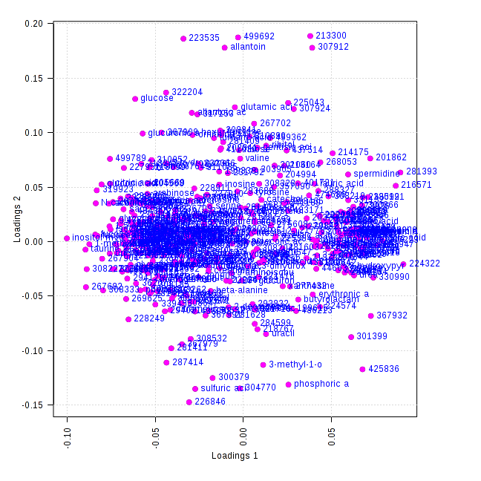
Chronic heart failure data analysis
- Samples were analyzed using GC-MS and data was processed through Binbase.
- PCA and loadings of J (sham), K (control), M (surgery) and My1 (surgery treated): data is log transformed and pareto scaled
M
J, K, My1

Slide 38
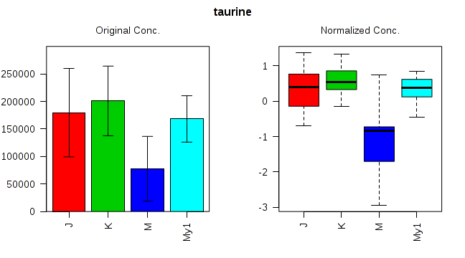
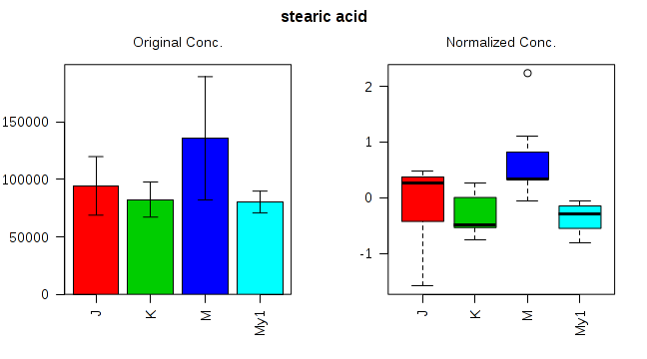
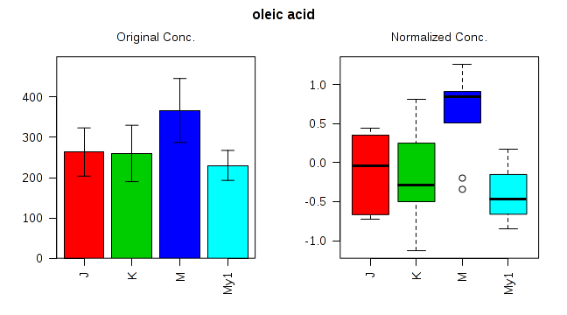
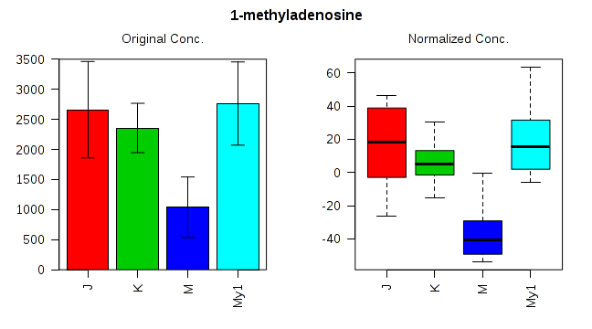
Taurine
Stearic Acid
Oleic acid
1-Methyladenosine

Slide 39
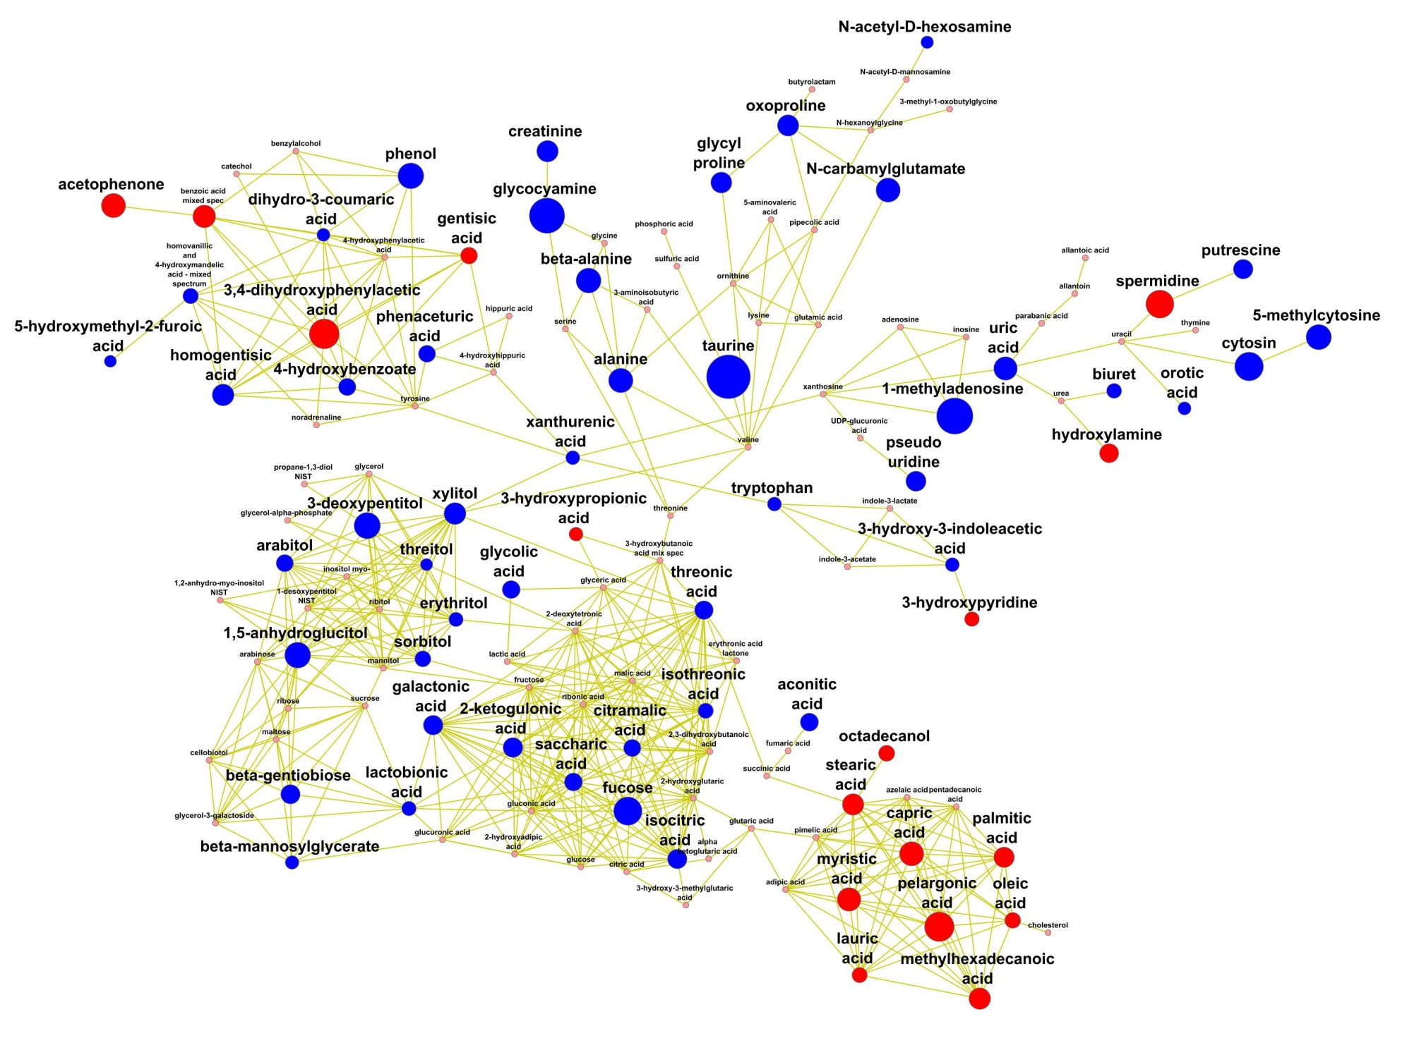
Control vs Surgery group
Organic acids
Aminoacids and derivatives
Carboxylic acids and sugar alcohols
Amides and amines
Fatty acids
Red: Metabolites upregulated in surgery group vs control (p<0.05)
Blue: Metabolites downregulated in surgery group vs control (p<0.05)
* Size represents fold change

Slide 40
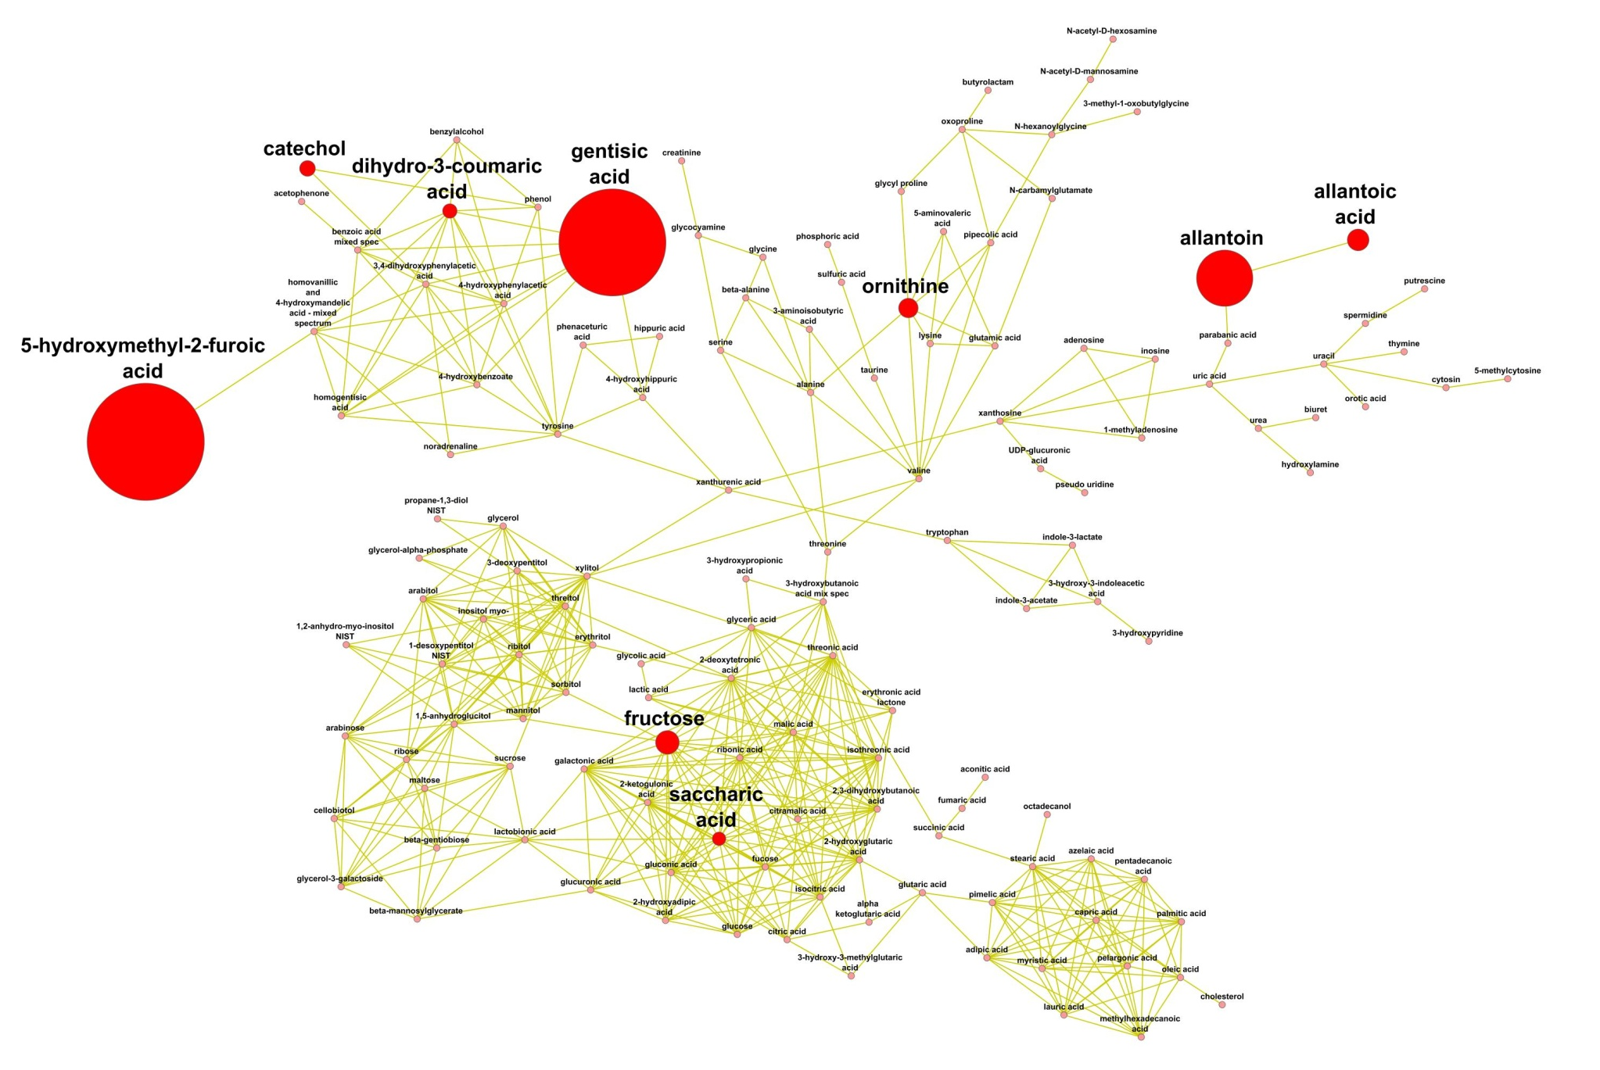
Control vs Surgery treated group
Organic acids
Aminoacids and derivatives
Amides and amines
Carboxylic acids and sugar alcohols
Fatty acids
Red: Metabolites upregulated in surgery group vs control (p<0.05)
Blue: Metabolites downregulated in surgery group vs control (p<0.05)
* Size represents fold change

Slide 41
Conclusions
4. There are many tools for data evaluation, processing and analysis of metabolomics data, each of them with their strengths and weaknesses. You need a lifetime to learn them all, so the most important thing is to know your data and what do you want to get from it.

Slide 42
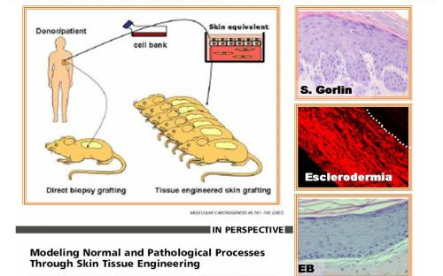


Future

Slide 43
Other take home notes…

Slide 44

Oliver
Tobias
Gert
Kevin
Sajjan
Mine
Mimi
Bill
John
Dominique
Arpana
Yan
Brian D.
Dmitry
Johannes
Tom
Zijuan
Jeannette
Ingrid
Alex
Angela
Mona
Joyce W.
Stephanie
Sharlene
Joyce L
Luis
Carol
Nancy
Narendra
Mark
Liz
Christine
Clara
Alberto
Lana
Erin
Deepika
Ben
Brian N.
Na
Sneh
Zipora
Kohei
Nobuo
Motofumi
Natalia
Marta
Diego
Ashwani
Vaganan
Dawei
Nutan
Montserrat
Dinesh
Reid

